Slide 1
Displaying Continuous Categorical Data
Miss L
Year 11 Essentials

Slide 2
24
7
30
Displaying Continuous Categorical Data
Date
EQ – How do we display continuous C.D?
Measuring Continuous Data
When we measure continuous data, we can not write an exact value down.
We only write down an approximation which is only as accurate as the measuring device.
Because of this we need to group the data into class intervals of equal width.
A histogram is used to display continuous data.

Slide 3
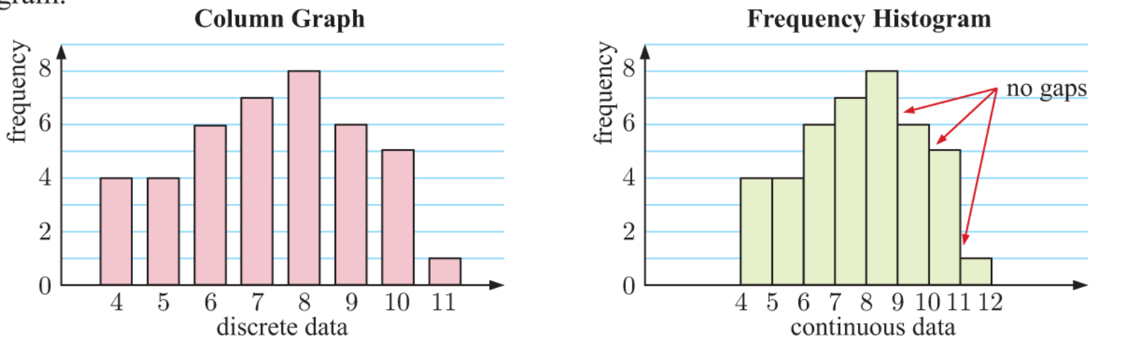
24
7
30
Displaying Continuous Categorical Data
Date
EQ – How do we display continuous C.D?

Slide 4


Slide 5
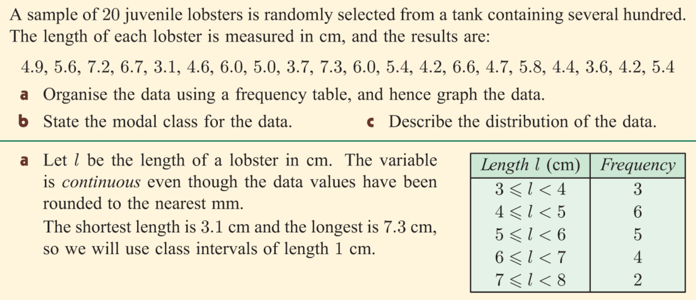
Practice

Slide 6
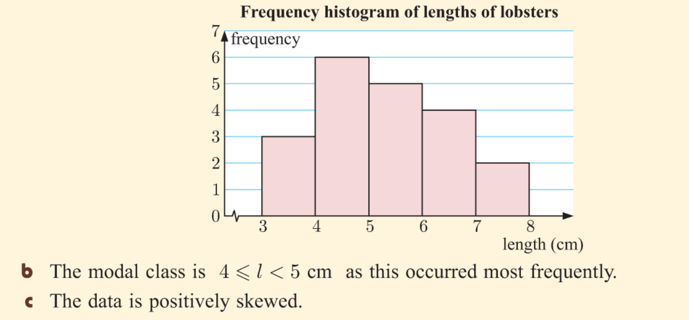
Practice

